Slide 1

Membrane antigen receptors- TcR
Dr. (Ms.) Sonali Correa

Slide 2
Introduction
T cell is a type of lymphocyte
T cells are one of the important white blood cells
T cells are born from hematopoietic stem cells, found in the bone marrow
Developing T cells then migrate to the thymus gland to develop (or mature).
Precursor cells mature into several distinct types of T cells.
T cell differentiation also continues after they have left the thymus.
Groups of specific, differentiated T cell subtypes have a variety of important functions in controlling and shaping the immune response.

Slide 3
T lymphocytes use co-receptors to bind to the MHC molecules. Co-receptors can be either CD4 or CD8.
CD proteins help to differentiate major groups of effector T lymphocytes.
Naïve CD8+ T lymphocytes will become cytotoxic T lymphocytes
CD4+ T lymphocytes will become T helper lymphocytes

Slide 4
 | Type | Stimulus cytokines | Transcription factor | Function | Effector molecules | Target organisms
CD8 | Cytotoxic T cells | IL-12IL-18 | T-betBlimp1 | Kills virus-infected cells. | GranzymePerforin TNF-α Fas ligand | Viruses
CD4 | T_{H}1 cells | IL-12IFN-γ IL-2 | T-bet | Activates macrophages. Helps cytotoxic T-cells. Provides B-cell help for antibody production | IL-12IFN-γ IL-2 | Intracellular (mycobacteria, listeria, leishmania) and extracellular bacteria.Fungi.
 | T_{H}2 cells | IL-4 | GATA3STAT6 | Provide help to B cells for antibody production- especially IgE antibodies. Activates eosinophils and mast cells. | IL-4IL-5 IL-13 | HelminthExtracellular Parasites

Slide 5
 | Type | Stimulus cytokines | Transcription factor | Function | Effector molecules | Target organisms
CD4 | T_{H}17 cells | IL-6IL-21 TGF-β | ROR-γTSTAT3 | Enhance neutrophil response. Improve epithelial barrier function. | IL-17IL-21 IL-22 IL-26 IL-6 | Extracellular bacteria (e.g. Salmonella enterica)
CD4 | TFH cells | IL-6IL-21 | Bcl6 | Germinal centre formation. B cell antibody isotype switching. Antibody affinity maturation. Enables B cells to develop into plasma cells for Long term humoral immunity | IL-10IL-21 IL-4
 | T regulatory cells | TGF-β | Foxp3 | Suppresses other immune cells, particularly CD4+ and CD8+ responses. | TGF-βIL-10 CTLA-4 | T regulatory cells

Slide 6
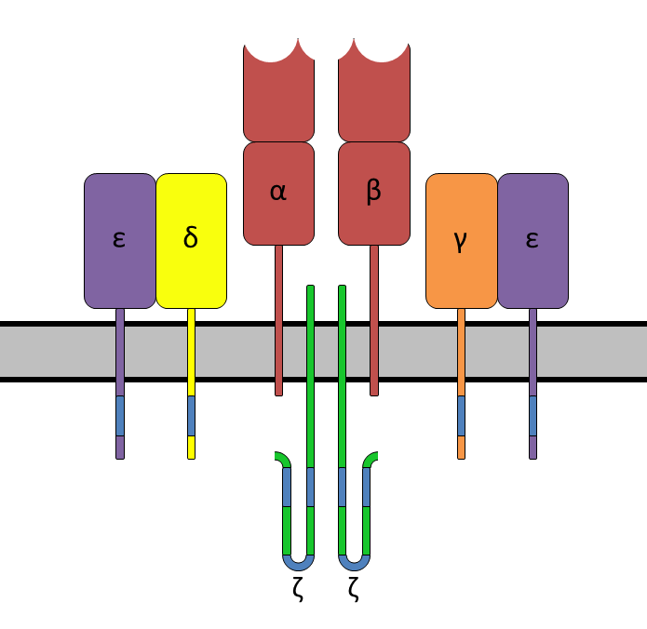
The T-cell receptor (TCR) is a protein complex found on the surface of T cells, or T lymphocytes
It is responsible for recognizing fragments of antigen as peptides bound to major histocompatibility complex (molecules. MHC)
The binding between TCR and antigen peptides is of relatively low affinity and is degenerate: ie, many TCRs recognize the same antigen peptide and many antigen peptides are recognized by the same TCR

Slide 7
Structural Characteristics
It is a disulfide-linked membrane-anchored heterodimeric protein In humans, in 95% of T cells the TCR consists of the highly variable alpha (α) and beta (β) chains expressed as part of a complex with the invariant CD3 chain molecules and are referred to as α:β (or αβ) T cells,
whereas in 5% of T cells the TCR consists of gamma and delta (γ/δ) chains (encoded by TRG and TRD, respectively)
Notes:
Transfer genes or tra genes (also transfer operons or tra operons), are some genes necessary for non-sexual transfer of genetic material in both gram-positive and gram-negative bacteria.

Slide 8
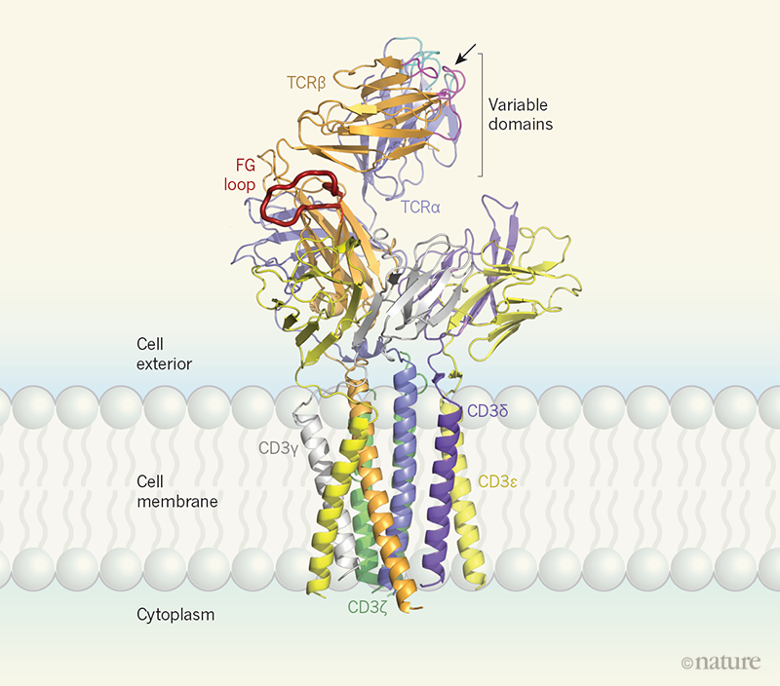
Variable (V) region and a Constant (C) region, both of Immunoglobulin superfamily (IgSF) domain forming antiparallel β-sheets.
The Constant region is proximal to the cell membrane, followed by a transmembrane region and a short cytoplasmic tail, while the Variable region binds to the peptide/MHC complex.
The variable domain of both the TCR α-chain and β-chain each have three hypervariable or CDRs.
There is also an additional area of hypervariability on the β-chain (HV4) that does not normally contact antigen and, therefore, is not considered a CDR
Notes:
The immunoglobulin superfamily (IgSF) is a class of proteins that are associated with the adhesion, binding and recognition processes of cells.
The immunoglobulin superfamily is a group of cell surface proteins characterized by the presence of a variable number of related 70–110 amino acid Ig-like domains originally described in the Ig variable and constant regions. Included are CD2, CD3, CD4, CD7, CD8, CD28, T cell receptor (TCR), MHC class I and MHC class II molecules, leukocyte function-associated antigen 3 (LFA-3), the IgG receptor, and a dozen other proteins
These molecules share in common with each other an immunoglobulin-like domain, with a length of approximately 100 amino acid residues and a central disulfide bond that anchors and stabilizes antiparallel β strands into a folded structure resembling immunoglobulin

Slide 9
Residues in these variable domains are located in two regions of the TCR, at the interface of the α- and β-chains and in the β-chain framework region that is thought to be in proximity to the CD3 signal-transduction complex.
CDR3 is the main CDR responsible for recognizing processed antigen,
CDR1 of the alpha chain has also been shown to interact with the N-terminal part of the antigenic peptide
CDR1 of the β-chain interacts with the C-terminal part of the peptide
CDR2 is thought to recognize the MHC
CDR4 of the β-chain is not thought to participate in antigen recognition, but has been shown to interact with superantigens
Notes:
Superantigens (SAgs) are a class of antigens that result in excessive activation of the immune system.
Specifically it causes non-specific activation of T-cells resulting in polyclonal T cell activation and massive cytokine release.
SAgs are produced by some pathogenic viruses and bacteria most likely as a defense mechanism against the immune system.
Compared to a normal antigen-induced T-cell response where 0.0001-0.001% of the body's T-cells are activated, these SAgs are capable of activating up to 20% of the body's T-cells.

Slide 10
The constant domain of the TCR consists of short connecting sequences in which a cysteine residue forms disulfide bonds, which form a link between the two chains
The TCR is similar to a half-antibody consisting of a single heavy and single light chain, except the heavy chain is without its crystallisable fraction (Fc) and the subunits are twisted together
the antibody uses its Fc region to bind to Fc Receptors on leukocytes, TCR is already docked onto the cell membrane
it is not able to mediate signal transduction itself due to its short cytoplasmic tail, so TCR still requires CD3 and zeta to carry out the signal transduction in its place
MHC-TCR-CD3 interaction for T cells is functionally similar to the antigen(Ag)-immunoglobulin(Ig)-FcR interaction for myeloid leukocytes, and Ag-Ig-CD79 interaction for B cells.
Notes:
Superantigens (SAgs) are a class of antigens that result in excessive activation of the immune system.
Specifically it causes non-specific activation of T-cells resulting in polyclonal T cell activation and massive cytokine release.
SAgs are produced by some pathogenic viruses and bacteria most likely as a defense mechanism against the immune system.
Compared to a normal antigen-induced T-cell response where 0.0001-0.001% of the body's T-cells are activated, these SAgs are capable of activating up to 20% of the body's T-cells.

Slide 11
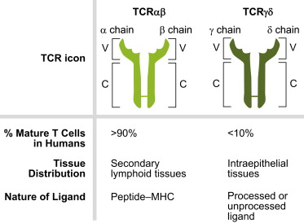

Slide 12
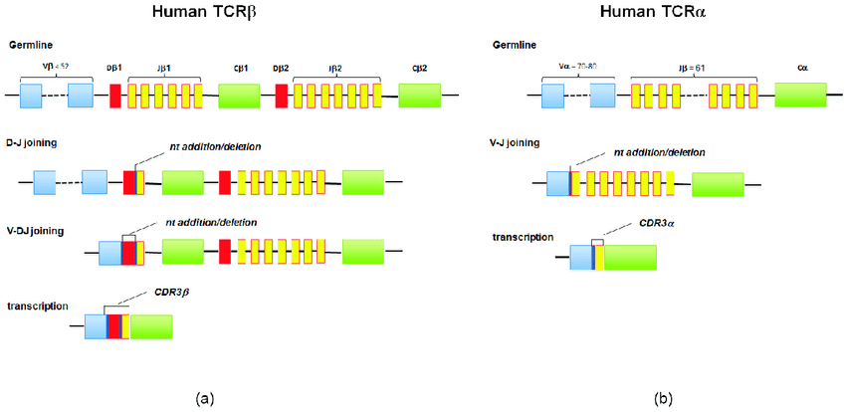
(a,b) The diversity of T-cell receptor (TCR)αβ is a result of genetic recombination and diversification mechanisms occurring at the α and β TCR chain loci. Diversity is first created in the germline via recombination of variable V, diversity D (for β chain), and joining J segments. Further diversification occurs through imprecise junctions of these gene segments (addition of P-and N-nucleotides adjacent to the D segment), and the combination of α and β chains.

Slide 13
The generation of TCR diversity is similar to that for antibodies and B-cell antigen receptors.
It arises mainly from genetic recombination of the DNA-encoded segments in individual somatic T cells by somatic V(D)J recombination using RAG1 and RAG2 recombinases.
TCR genes do not undergo somatic hypermutation, and T cells do not express activation-induced cytidine deaminase(AID).
The recombination process that creates diversity in BCR (antibodies) and TCR is unique to lymphocytes (T and B cells) during the early stages of their development in primary lymphoid organs (thymus for T cells, bone marrow for B cells).
Each recombined TCR possess unique antigen specificity, determined by the structure of the antigen-binding site formed by the α and β chains in case of αβ T cells or γ and δ chains on case of γδ T cells
The TCR alpha chain is generated by VJ recombination, whereas the beta chain is generated by VDJ recombination (both involving a random joining of gene segments to generate the complete TCR chain
generation of the TCR gamma chain involves VJ recombination, whereas generation of the TCR delta chain occurs by VDJ recombination.
ntersection of these specific regions (V and J for the alpha or gamma chain; V, D, and J for the beta or delta chain) corresponds to the CDR3 region that is important for peptide/MHC recognition

Slide 14
It is the unique combination of the segments at this region, along with palindromic and random nucleotide additions (respectively termed "P-" and "N-"), which accounts for the even greater diversity of T-cell receptor specificity for processed antigenic peptides.
individual CDR loops of TCR can be re-edited in the periphery outside thymus by reactivation of recombinases using a process termed TCR revision (editing) and change its antigenic specificity.

Slide 15
TCR complex
In the plasma membrane the TCR receptor chains α and β associate with six additional adaptor proteins to form an octameric complex
The complex contains both α and β chains, forming the ligand-binding site, and the signalling modules CD3δ, CD3γ, CD3ε and CD3ζ in the stoichiometry TCR α β - CD3εγ - CD3εδ - CD3ζζ
Charged residues in the transmembrane domain of each subunit form polar interactions allowing a correct and stable assembly of the complex
The cytoplasmic tail of the TCR is extremely short, hence the CD3 adaptor proteins contain the signalling motifs needed for propagating the signal from the triggered TCR into the cell

Slide 16
The signalling motifs involved in TCR signalling are tyrosine residues in the cytoplasmic tail of these adaptor proteins that can be phosphorylated in the event of TCR-pMHC binding
The tyrosine residues reside in a specific amino acid sequence of the signature Yxx(L/I)x6-8Yxx(L/I), where Y, L, I indicate tyrosine, leucine and isoleucine residues, x denotes any amino acids, the subscript 6-8 indicates a sequence of 6 to 8 amino acids in length
This motif is very common in activator receptors of the non-catalytic tyrosine-phosphorylated receptor (NTR) family and is referred to as immunoreceptor tyrosine-based activation motif (ITAM)
CD3δ, CD3γ and CD3ε each contain a single ITAM, while CD3ζ contains three ITAMs. In total the TCR complex contains 10 ITAMs
Phosphorylated ITAMs act as binding site for SH2-domains of additionally recruited proteins.

Slide 17
Antigen discrimination
Each T cell expresses clonal TCRs which recognize a specific peptide loaded on a MHC molecule (pMHC), either on MHC class II on the surface of antigen-presenting cells or MHC class I on any other cell type
A unique feature of T cells is their ability to discriminate between peptides derived from healthy, endogenous cells and peptides from foreign or abnormal (e.g. infected or cancerous) cells in the body
T cells undergo positive selection in the thymus, there is a non-negligible affinity between self-pMHC and the TCR

Slide 18
the T-cell receptor signalling should not be activated by self-pMHC so that endogenous, healthy cells are ignored by T cells
The ability of T cells to ignore healthy cells but respond when these same cells express a small number of foreign pMHCs is known as antigen discrimination
T cells have a very high degree of antigen specificity, despite the fact that the affinity to the peptide/MHC ligand is rather low in comparison to other receptor types

Slide 19
Signaling pathway
The essential function of the TCR complex is to identify specific bound antigen derived from a potentially harmful pathogen and elicit a distinct and critical response.
The signal transduction mechanism by which a T cell elicits this response upon contact with its unique antigen is termed T-cell activation
Upon binding to pMHC, the TCR initiates a signalling cascade, involving transcription factor activation and cytoskeletal remodelling resulting in T cell activation

Slide 20
Active T cells secrete cytokines, undergo rapid proliferation, have cytotoxic activity and differentiate into effector and memory cells.
When the TCR is triggered, T cells form an immunological synapse allowing them to stay in contact with the antigen presenting cell for several hours
T cell activation depends on the strength of TCR stimulation, the dose–response curve of ligand to cytokine production is sigmoidal
T cell activation on a single cell level can be characterised by a digital switch-like response, meaning the T cell is fully activated if the stimulus is higher than a given threshold, otherwise the T cell stay in its non-activated state.

Slide 21
Signal 1
Signal 3
Signal 2
is provided by the T-cell receptor when recognising a specific antigen on a MHC molecule.
comes from co-stimulatory receptors such as CD28, presented on the surface of other immune cells. It is expressed only when an infection was detected by the innate immune system, it is a "Danger indicating signal". This two-signal system makes sure that T cells only respond to harmful pathogens and not to self-antigens.
is provided by cytokines, which regulate the differentiation of T cells into different subsets of effector T cells.
There are myriad molecules involved in the complex biochemical process (called trans-membrane signaling) by which T-cell activation occurs.

Slide 22
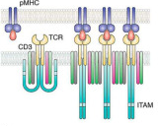
Receptor activation
The initial triggering follows the mechanism common for all NTR receptor family members.
Once the TCR binds a specific pMHC, the tyrosine residues of the ITAMs in its CD3 adaptor proteins are phosphorylated.
The residues serve as docking sites for downstream signalling molecules, which can propagate the signal
Phosphorylation of ITAMs is mediated by the Src kinase Lck.
Lck is anchored to the plasma membrane by associating with the co-receptor CD4 or CD8, depending on the T cell subtype
CD4 is expressed on helper T cells and regulatory T cells, and is specific for MHC class II. CD8, on the other hand, specific for MHC class I, is expressed on cytotoxic T cells.
In the aggregation model, pMHC binding induces oligomerization of TCR–CD3 complexes. This clustering could increase the proximity of associated Lck molecules, resulting in activation of receptors in the aggregate by trans-autophosphorylation

Slide 23
Binding of the co-receptor to the MHC brings Lck in close proximity to the CD3 ITAMs
It has been shown that 40% of Lck is active even before the TCR binds pMHC and therefore has the ability to constantly phosphorylate the TCR.
Tonic TCR signalling is avoided by the presence of phosphatase CD45 that removes phosphorylation from tyrosine residues and inhibits signal initiation

Slide 24
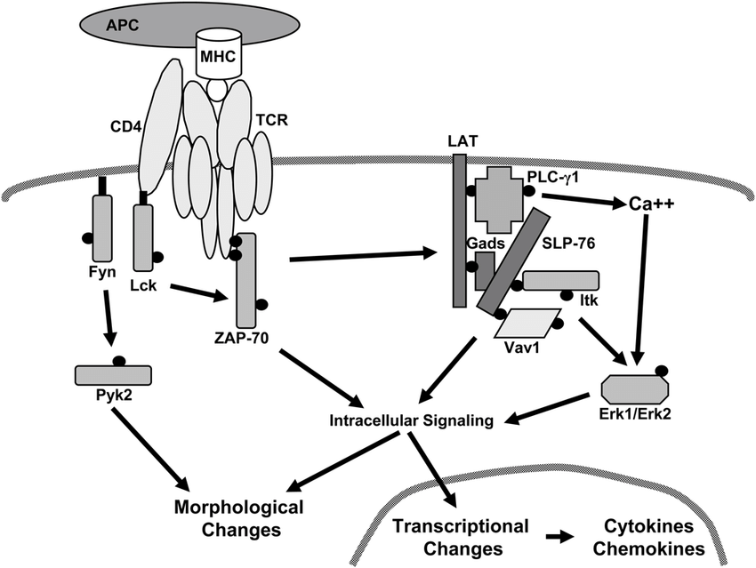
Proximal TCR signaling
Phosphorylated ITAMs in the cytoplasmic tails of CD3 recruit protein tyrosine kinase Zap70 that can bind to the phosphorylated tyrosine residues with its SH2 domain.
This brings Zap70 into close proximity to Lck which results to its phosphorylation and activation by Lck.
Lck phosphorylates a number of different proteins in the TCR pathway.
Zap70 is able to phosphorylate multiple tyrosine residues of the transmembrane protein LAT (Linker for activation of T cells ). LAT is a scaffold protein associated with the membrane
Notes:
Linker for activation of T cells (LAT) and protein tyrosine phosphatase non-receptor type 22 (PTPN22) have roles in activating TCR feedback loops, as revealed from studies of individuals with point mutations or of mice with loss of expression of these molecules. Disruption of the normal function of these molecules can lead to inflammatory and autoimmune disorders.

Slide 25
LAT associates with another scaffolding protein Slp-76 via the Grap2 adaptor protein, which provides additional binding sites
LAT and Slp-76 provide a platform for the recruitment of many downstream signalling molecules
LAT/Slp76 complex act as a highly cooperative signalosome
Molecules that bind the LAT/Slp76 complex include: Phospholipase Cγ1 (PLCγ1), SOS via a Grb2 adaptor, Itk, Vav, Nck1 and Fyb

Slide 26
Signal transduction to the nucleus
PLCγ is a very important enzyme in the pathway as it generates second messenger molecules
Direct activation of the human phospholipase C-γ isozymes (PLC-γ1, -γ2) by tyrosine phosphorylation is fundamental to the control of diverse biological processes, including chemotaxis, platelet aggregation, and adaptive immunity
It is activated by the tyrosine kinase Itk which is recruited to the cell membrane by binding to Phosphatidylinositol (3,4,5)-trisphosphate (PIP3)
Notes:
Direct activation of the human phospholipase C-γ isozymes (PLC-γ1, -γ2) by tyrosine phosphorylation is fundamental to the control of diverse biological processes, including chemotaxis, platelet aggregation, and adaptive immunity

Slide 27
PIP3 is produced by the action of Phosphoinositide 3-kinase(PI-3K), which phosphorylates Phosphatidylinositol 4,5-bisphosphate (PIP2) to produce PIP3.
The interaction between PLCγ, Itk and PI-3K could be the point in the pathway where the first and the second signal are integrated
Only if both signals are present, PLCγ is activated.
Once PLCγ is activated by phosphorylation, it hydrolyses PIP2 into two secondary messenger molecules, namely the membrane-bound diacyl glycerol(DAG) and the soluble inositol 1,4,5-trisphosphate (IP3).
These second messenger molecules amplify the TCR signal and distribute the prior localised activation to the entire cell and activate protein cascades that finally lead to the activation of transcription factors( regulation of genes inorder to express them)
Transcription factors involved : are the NFAT, NF-κB and AP1, a heterodimer of proteins Fos and Jun.
All three transcription factors are needed to activate the transcription of interleukin-2(IL2) gene.

Slide 28
NFAT
NFAT activation depends on calcium signaling
IP3 produced by PLC-γ is no longer bound to the membrane and diffuses rapidly in the cell
Binding of IP3 to calcium channel receptors on the endoplasmic reticulum (ER) induces the release of calcium (Ca2+) into the cytosol
The resulting low Ca2+ concentration in the ER causes STIM1 clustering on the ER membrane, which in turn leads to activation of cell membrane CRAC channels that allows additional calcium to flow into the cytosol from the extracellular space
Notes:
Direct activation of the human phospholipase C-γ isozymes (PLC-γ1, -γ2) by tyrosine phosphorylation is fundamental to the control of diverse biological processes, including chemotaxis, platelet aggregation, and adaptive immunity

Slide 29
This cytosolic calcium binds calmodulin, inducing a conformational change of the protein such that it can then bind and activate calcineurin
Calcineurin, in turn, dephosphorylates NFAT. In its deactivated state, NFAT cannot enter the nucleus as its nuclear localisation sequence (NLS) cannot be recognised by nuclear transporters due to phosphorylation by GSK-3
When dephosphorylated by Calcineurin translocation of NFAT into the nucleus is possible
PI-3K via signal molecules recruits the protein kinase AKT to the cell membrane.
AKT is able to deactivate GSK3 and thereby inhibiting the phosphorylation of NFAT, which could contribute to NFAT activation

Slide 30
NF-κB
Nuclear factor kappa-light-chain-enhancer plays a critical role in regulating the survival, activation and differentiation of innate immune cells and inflammatory T cells
NF-κB activation is initiated by DAG
DAG binds and recruits Protein kinase C θ (PKCθ) to the membrane where it can activated the membrane bound scaffold protein CARMA1 Capsase recruitment domain containing protein aka CARD
CARMA1 then undergoes a conformational change which allow it to oligomerise and bind the adapter proteins BCL10, CARD domain and MALT1 Mucosa-associated lymphoid tissue lymphoma translocation protein 1
This multi-subunit complex binds the Ubiquitin ligase TRAF6
Notes:
The transcription factor NF-κB regulates multiple aspects of innate and adaptive immune functions and serves as a pivotal mediator of inflammatory responses. NF-κB induces the expression of various pro-inflammatory genes, including those encoding cytokines and chemokines, and also participates in inflammasome regulation.

Slide 31
Ubiquitination of TRAF6 serves as scaffold to recruit NEMO, IκB kinase (IKK) and TAK1
AK 1 phosphorylates IKK, which in turn phosphorylates the NF-κB inhibitor I-κB, leading to the ubiquitination and subsequent degradation of I-κB. I-κB blocks the NLS of NF-κB therefore preventing its translocation to the nucleus
I-κB is degraded, it cannot bind to NF-κB and the NLS of NF-κB becomes accessible for nuclear translocation

Slide 32
AP1
Activation of AP1 involves three MAPK signalling pathways which use a phosphorylation cascade of three successive acting protein kinases to transmit a signal.
The three MAPK pathways in T cells involve kinases of different specificities belonging to each of the MAP3K, MAP2K, MAPK families
Initial activation is done by the GTPase Ras or Rac which phosphorylate the MAP3K
A cascade involving the enzymes Raf, MEK1, ERK results in the phosphorylation of Jun, conformational change allows Jun to bind to Fos and hence AP-1 to form
Notes:
The transcription factor NF-κB regulates multiple aspects of innate and adaptive immune functions and serves as a pivotal mediator of inflammatory responses. NF-κB induces the expression of various pro-inflammatory genes, including those encoding cytokines and chemokines, and also participates in inflammasome regulation.

Slide 33
AP-1 then acts as transcription factor.
Raf is activated via the second messenger DAG, SOS, and Ras.
DAG recruits among other proteins the RAS guanyl nucleotide-releasing protein (RasGRP), a guanine nucleotide exchange factor (GEF), to the membrane.
RasGRP activates the small GTPase Ras by exchanging Guanosine diphosphate (GDP) bound to Ras against Guanosine triphosphate (GTP).
Ras can also be activated by the guanine nucleotide exchange factor SOS which binds to the LAT signalosome.
Ras then initiates the MAPK cascade.
The second MAPK cascade with MEKK1, JNKK, JNK induces protein expression of Jun.
Another cascade, also involving MEKK1 as MAPK3, but then activating MKK3 /6 and p38 induces Fos transcription.
Activation of MEKK1, additionally to being activated by Ras, involves Slp-76 recruiting the GEF Vav to the LAT signalosome, which then activates the GTPase Rac. Rac and Ras activate MEKK1 and thereby initiate the MAPK cascade

Slide 34
CD8 Co-Receptor
The CD8 co-receptor is predominantly expressed on the surface of cytotoxic T cells, but can also be found on natural killer cells, cortical thymocytes, and dendritic cells.
The CD8 molecule is a marker for cytotoxic T cell population.
It is expressed in T cell lymphoblastic lymphoma and hypo-pigmented mycosis fungoides

Slide 35
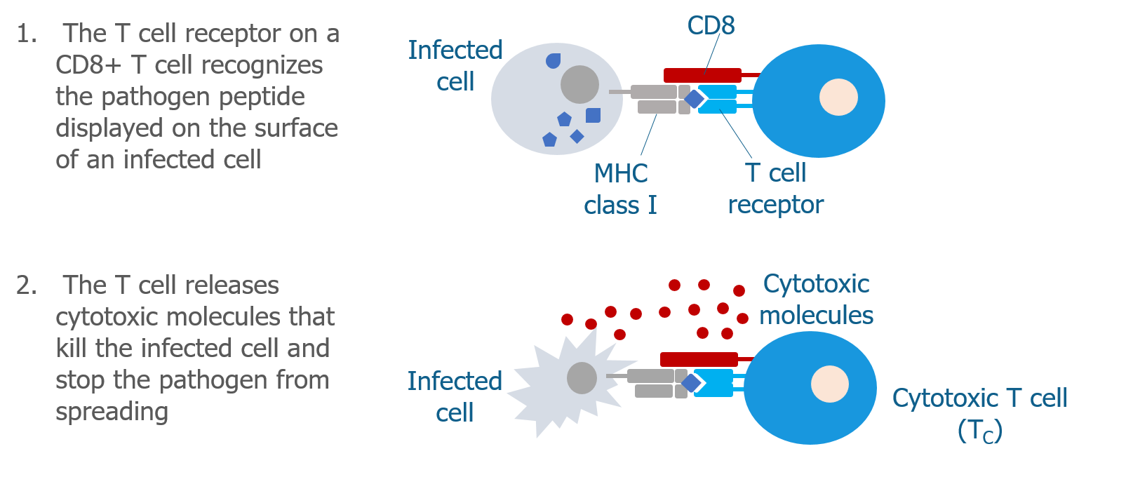

Slide 36
Structure
To function, CD8 forms a dimer, consisting of a pair of CD8 chains.
The most common form of CD8 is composed of a CD8-α and CD8-β chain, both members of the immunoglobulin superfamily with an immunoglobulin variable (IgV)-like extracellular domain connected to the membrane by a thin stalk, and an intracellular tail.
The molecular weight of each CD8 chain is about 34 kDa

Slide 37
Function
The extracellular IgV-like domain of CD8-α interacts with the α₃ portion of the Class I MHC molecule
This affinity keeps the T cell receptor of the cytotoxic T cell and the target cell bound closely together during antigen-specific activation. Cytotoxic T cells with CD8 surface protein are called CD8+ T cells.
The main recognition site is a flexible loop at the α3 domain of an MHC molecule
The flexible α3 domain is located between residues 223 and 229 in the genome
In addition to aiding with cytotoxic T cell antigen interactions the CD8 co-receptor also plays a role in T cell signaling

Slide 38
The cytoplasmic tails of the CD8 co-receptor interact with Lck (lymphocyte-specific protein tyrosine kinase).
Once the T cell receptor binds its specific antigen Lck phosphorylates the cytoplasmic CD3 and ζ-chains of the TCR complex which initiates a cascade of phosphorylation eventually leading to activation of transcription factors like NFAT, NF-κB, and AP-1 which affect the expression of certain genes.

Slide 39
CD4
In molecular biology, CD4 (cluster of differentiation 4) is a glycoprotein that serves as a co-receptor for the T-cell receptor (TCR).
CD4 is found on the surface of immune cells such as T helper cells, monocytes, macrophages, and dendritic cells.
originally known as leu-3 and T4 (after the OKT4 monoclonal antibody that reacted with it) before being named CD4 in 1984
CD4 protein is encoded by the CD4 gene

Slide 40
CD4+ T helper cells are white blood cells that are an essential part of the human immune system.
They are often referred to as CD4 cells, T-helper cells or T4 cells.
They are called helper cells because one of their main roles is to send signals to other types of immune cells, including CD8 killer cells, which then destroy the infectious particle.
If CD4 cells become depleted, for example in untreated HIV infection, or following immune suppression prior to a transplant, the body is left vulnerable to a wide range of infections that it would otherwise have been able to fight.

Slide 41
Structure
CD4 is a member of the immunoglobulin superfamily.
It has four immunoglobulin domains (D1 to D4) that are exposed on the extracellular surface of the cell:
D1 and D3 resemble immunoglobulin variable (IgV) domains.
D2 and D4 resemble immunoglobulin constant (IgC) domains.
The immunoglobulin variable (IgV) domain of D1 adopts an immunoglobulin-like β-sandwich fold with seven β-strands in 2 β-sheets

Slide 42
CD4 interacts with the β2-domain of MHC class II molecules through its D1 domain.
T cells displaying CD4 molecules (and not CD8) on their surface, therefore, are specific for antigens presented by MHC II and not by MHC class I (they are MHC class II-restricted). MHC class I contains Beta-2 microglobulin.
The short cytoplasmic/intracellular tail (C) of CD4 contains a special sequence of amino acids that allow it to recruit and interact with the tyrosine kinase Lck.

Slide 43
Function
CD4 is a co-receptor of the T cell receptor (TCR) and assists the latter in communicating with antigen-presenting cells.
The TCR complex and CD4 bind to distinct regions of the antigen-presenting MHC class II molecule.
The extracellular D1 domain of CD4 binds to the β2 region of MHC class II. The resulting close proximity between the TCR complex and CD4 allows the tyrosine kinase Lck bound to the cytoplasmic tail of CD4 to phosphorylate tyrosine residues of immunoreceptor tyrosine activation motifs (ITAMs) on the cytoplasmic domains of CD3 to amplify the signal generated by the TCR

Slide 44
. Phosphorylated ITAMs on CD3 recruit and activate SH2 domain-containing protein tyrosine kinases (PTK), such as ZAP70, to further mediate downstream signalling through tyrosine phosphorylation.
These signals lead to the activation of transcription factors, including NF-κB, NFAT, AP-1, to promote T cell activation.

Slide 45
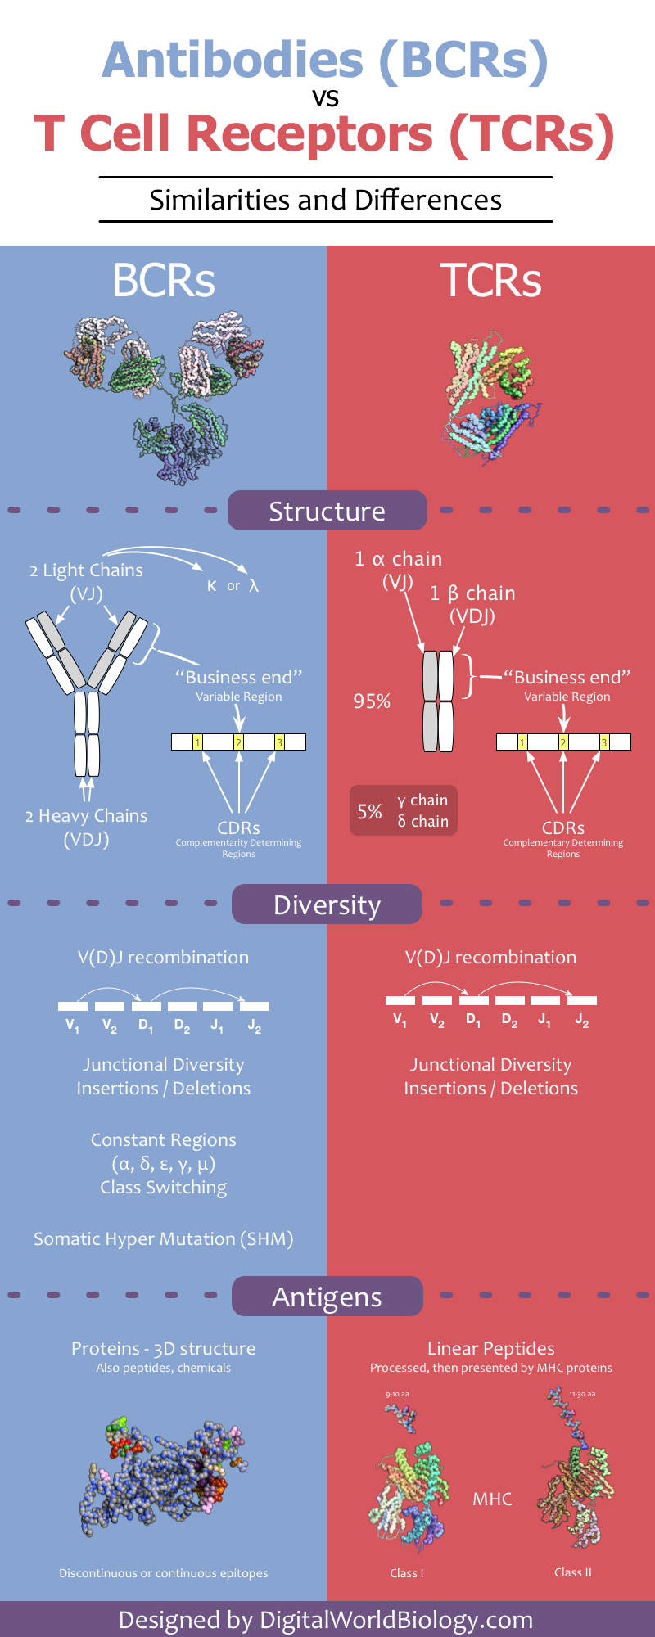

Slide 46
